Slide 1

School of Computer Engineering
Presentation for CIS Mini Project
Key Stroke Logger
Students Name:
Ved Gunjal. (202402040002)
Yash Chavan. (202402040004)
Hari Sharma.(202402040014)
Harshali Sable.(202402040020)
Guide : Mrs. Neha Hajare.

Slide 2
Index
Introduction
Literature survey
Problem Statement and Objectives
Proposed Block Diagram
Methodology
References

Slide 3

Introduction
• Traditional keylogging tools are risky and often misused, which creates the need for a safe and controlled logging environment.
• Secure Logger captures keystrokes ethically and protects them using encryption, hashing, and RSA-based digital signatures.
• The CustomTkinter interface allows users to easily start/stop logging, choose algorithms, and view encrypted or verified logs.
• The system ensures that data cannot be altered or accessed without verification, making it ideal for security learning, research, and digital forensics.

Slide 4
What Is AI Powered Book Marketplace?
• Safe Keystroke Monitoring:
Secure Logger captures keyboard activity in a controlled and ethical way, mainly for learning, research, and forensic purposes.
• Instant Encryption:
Every keystroke is protected immediately using AES, TripleDES, or RC4 so nothing is saved in plain text.
• Tamper Detection:
The system uses hashing and RSA digital signatures to ensure that no one can modify or fake the log files.
• Simple User Interface:
With a clean CustomTkinter GUI, users can easily start or stop logging, choose encryption methods, and safely view encrypted or verified logs.
Customer
Book (Genres, Author)
Personalized AI chatbot
Interactive Interface

Slide 5
Problem statement
To enhance the user experience on an online book-selling platform by providing an AI-powered chatbot that answers questions related to specific books, helping users make informed purchase decisions.
Objectives to be acheived :
To enhance user satisfaction and loyalty.
To offer secure payment methods for the security of customers.
To collect user feedback and data.

Slide 6
Literature Survey
Sr no. | Title of papers | Year | Authors | Findings
1 | Book Recommendation System Based on Combine Features of Content Based Filtering, Collaborative Filtering and Association Rule Mining | 2020 | Tewari, A. S., Kumar, A., & Barman. | We will incorporate the research from this paper into our book-selling platform to enhance its performance by leveraging their findings on the book market, improving recommendation accuracy and user experience.
2 | Design and Evaluation of Interactive Learning Story and User Interface Prototyping for Mobile Responsive Learning Application | 2021 | Phunkaew, T., Phandan, C., & Wongwatkit | In this research paper the authors have written about the Interactive User Interface. And from the research paper we will implement the interactive interface in our project.
3 | E-payment Gateway Model | 2022 | Anuja Pande , Prof. A.B. Deshmukh , Prof.M. D. Tambakhe | This research paper is about E-payment gateway model. From this research paper we have learned to implement a payment gateway.

Slide 7
Sr no. | Title of papers | Year | Author | Findings
4 | Implementing a chatbot in a library website | 2023 | Michelle Ehrenpreis John P. DeLooper | This research paper is about implementing and training a chatbot for the personal library. From this we will apply a chatbot learning capability in our project.
5 | Detecting Product Review Spammers using Rating Behaviors | 2024 | Lim, E.P., Nguyen, V.A., Jindal, N., Liu, B. and Lauw, H.W., | From this research paper authors are able to detect product review spammers using rating behaviors. And from this research paper we will implement review and rating feature.

Slide 8
Applications
Library: Our book selling website can be used by various libraries to buy antique books and ancient books of readers choice.
Students: Our book selling website can help some of the students which are upcoming aspirants of MPSC or UPSC as our website will also contain educational books.
Books readers: Our book selling website will also be usefull for the book readers who are book lovers and loves to read all kind of books.

Slide 9
Hardware and Software requirements
Software requirements:
MySQL for database.
PHP for server side scripting.
JavaScript for user interface.
Payment API for payment integration.
Hardware requirements:
Processor: Minimum i5 processor.
RAM: 8 GB or higher.
Network: Good internet connection with low latency (minimum 100 kbps)
Operating System: Linux (Ubuntu/CentOS) or Windows .

Slide 10
Block Diagram
https://drive.google.com/file/d/1TlyLS4BK98wN9UUWN3zDzLeh2W1tYxAY/view?usp=drive_link

Slide 11
Block Diagram explaination:
Step 1: User will register himself on our platform.
Step 2: User will see the homepage where all books will be listed according to there generes.
Step 3: The books and data will be fetched from the database, the user can also interact with chatbot to know more about the book.
Step 4: If user wants to buy the book he/her will click on the add to cart button, the book will be added to the cart and user will be redirected to the cart page.
Step 5: Then after clicking on checkout page, user will be asked for his/her address and all.
Step 6: Finally the payment gateway comes, user will do the payment.
Step 7: The user’s selected book will be processed for the delivery after payment is done.

Slide 12
Methodology
Choosing a suitable technology stack: We will be selecting appropriate programming languages, frameworks, and databases that are efficient, scalable, and secure.
Designing the user interface: We will be creating a user-friendly and intuitive interface that allows easy navigation and browsing.
Developing the book database: Then our next task will be to structure database to store information about books, including titles, authors, genres, descriptions, prices, and availability.
Integrating personalized chatbots: Then we will develop or integrate a chatbot system that can be associated with each book and provide personalized recommendations and information.
Training a chatbot for each book: Then we will train the chatbot to provide information about specific book.
Selecting a secure payment gateway: Our final task will be to select a appropriate and affordable payment gateway.

Slide 13
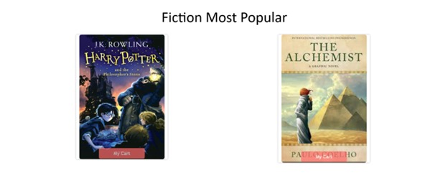
Screen shots of project
Books with generes mentioned

Slide 14
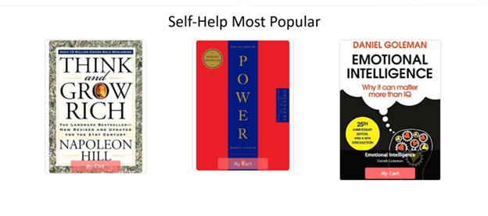

Slide 15


Slide 16


Slide 17
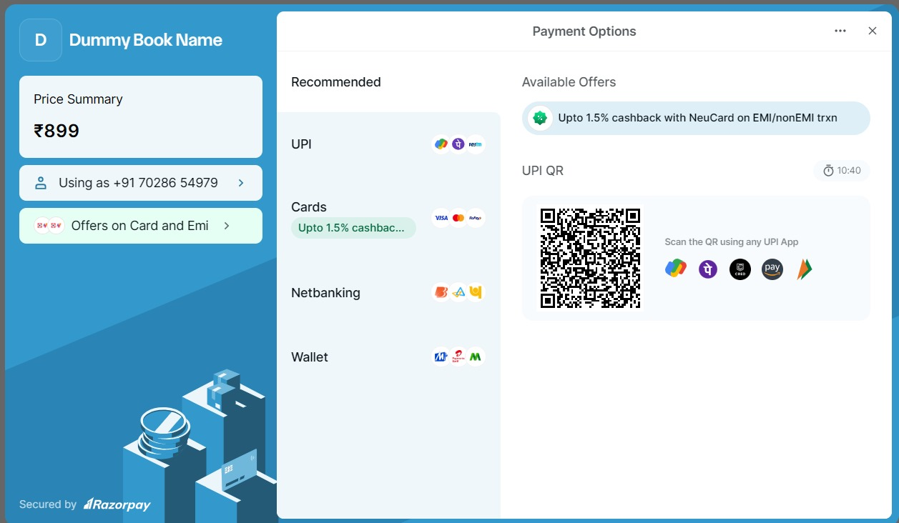

Slide 18
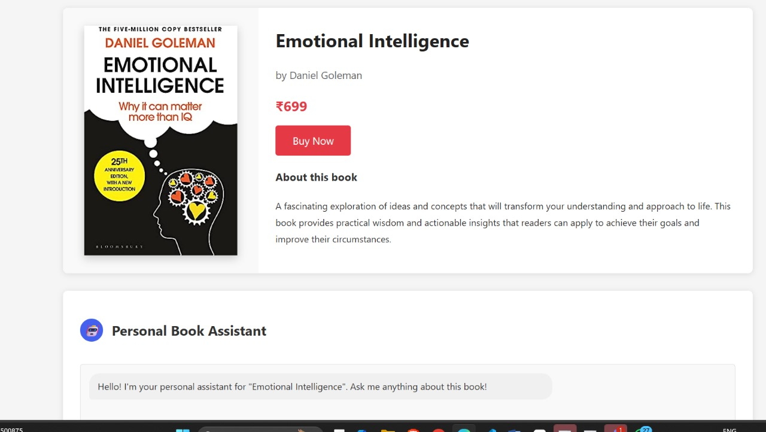

Slide 19
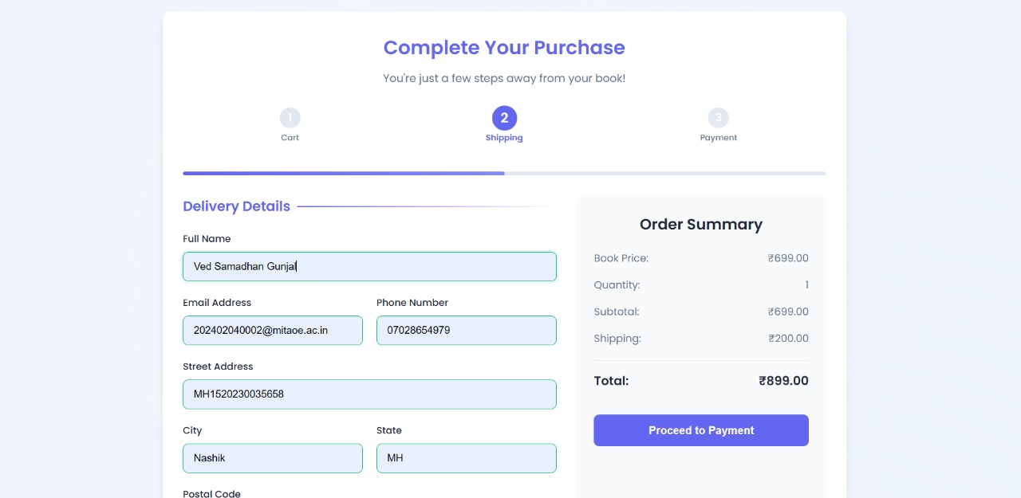

Slide 20
Future work and conclusion
Future work:
ln future we are willing to make whole process of books fetching with recommendation automatic using AI automation.
We will also add the cookies future to show the book recomendation according to users search history.
Conclusion:We have created an advanced book marketplace with smart technology, an easy-to-use interface, a large book collection, helpful chatbots, and safe payment options. This platform will make buying books simple and fun, catering to different reader needs.

Slide 21
References
Zhang, Y., & Benyoucef, M. (2021). The impact of artificial intelligence on online customer service: Evidence from China. Electronic Commerce Research and Applications, 47, 101053.
Tewari, A. S., Kumar, A., & Barman, A. G. (2014). Book recommendation system based on combine features of content based filtering, collaborative filtering and association rule mining. 2014 IEEE International Advance Computing Conference (IACC). doi:10.1109/iadcc.2014.6779375
Davenport, T. H., Guha, A., Grewal, D., & Bressgott, T. (2020). How artificial intelligence is transforming marketing. Journal of Advertising Research, 60(1), 4-20.
Lee, J. S., Dabirian, A., McCarthy, I. P., & Kietzmann, J. (2020). The effect of artificial intelligence on online consumer behavior: A conceptual framework. Internet Research, 30(4), 1207-1224.
Michelle Ehrenpreis and John P. DeLooper, "Implementing a chatbot on a library website," Journal of Web Librarianship 16.2 (2022): 120-142.

Slide 22
Thank You!!
Any Questions??

